Slide 1
Cloud Computing
Module 6

Slide 2
Cloud Computing Computing – Text Books
Modules 1 to 4 - Kai Hwang , Geoffrey C Fox, Jack J Dongarra : “Distributed and Cloud Computing – From Parallel Processing to the Internet of Things” , Morgan Kaufmann Publishers – 2012.
Module 5 – John W Rittinghouse and James F Ransome , “Cloud Computing: Implementation – Management – and Security”, CRC Press, 2010.
Module 6 - Michael Miller, “Cloud Computing: Web-Based
Applications That Change the Way You Work and Collaborate Online”, Pearson Education, 2009.

Slide 3
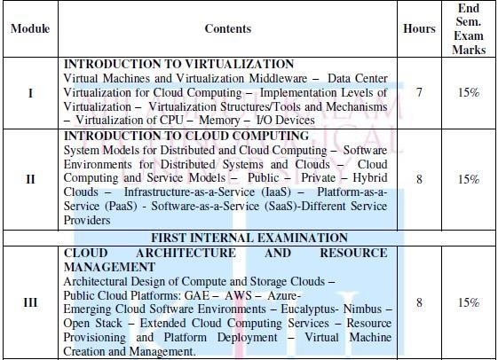
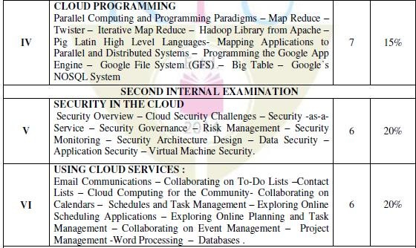

Slide 4
Cloud Computing for the Family

Slide 5
Centralizing Email Communications
Before cloud computing, the email access was via single computer.
Email clients (e.g. Microsoft Outlook, Outlook Express etc.) were used to fetch the mail.
Messages get directly downloaded to the PC.
Disadvantages
Cannot access mails from multiple locations.
Sync issues with home pc and ISP web page

Slide 6
Centralizing Email Communications
Solution is to use web based application which are hosted in cloud.
Popular applications – Gmail, Yahoo Mail. Microsoft Live Hotmail etc.
Advantages
Mails can be accessed from anywhere having a PC with internet connection.
Unlike email clients, these cloud applications are versatile.
Easy to setup and use.
Only needs to remember username and password.

Slide 7
Collaborating on Schedules
Scheduling can be done using cloud hosted web applications.
Popular applications – Google Calendar, Yahoo Calendar.
Advantages
Can be accessed from anywhere having a PC with internet connection
Can add family people, friends to one’s calendar.
User can see all the events recorded by other members of the group while adding an event.
Help to make decision in adding a conflicting or to reschedule the event to another date.

Slide 8
Collaborating on Contact Lists
There will be quite numbers of contacts associated with a family.
Contacts lists can be collaborated efficiently using cloud hosted web applications.
Popular applications – Contact management programs offered by Google, Yahoo etc..
Advantages
Provides complete information of your contacts which includes email address, postal address, phone number etc.
Applications like MyEvents and Highrise provide more feature at home user
level by managing holiday or function card list.

Slide 9
Cloud Computing for the Community

Slide 10
Communicating Across the Community
Community can make use of web- based email programs for communication.
Popular applications – Gmail, Yahoo Mail. Microsoft Live Hotmail etc.
Advantages
Mails can be accessed from anywhere having a PC with internet connection.
Mails are always available in the cloud.
Easy to setup and use.
Only needs to remember username and password.

Slide 11
Collaborating on Schedules
Lot of cloud based scheduling applications are available which will collaborate the activities across the community.
Some common scheduling activities are:
Sports Team Scheduling
Deals with scheduling the activities of a sportsman or athlete.
A player has different activities for his/her practices, home game, away game, team
meeting, meeting with the coach etc..
Some commonly used applications are Google Calendar, Yahoo Calendar or CalendarHub.
There are sports dedicated scheduling application which gives more feature like complete schedule, player profile, box scores etc..
E.g., League Athletics, League Lineup, Team Snap.

Slide 12
Collaborating on Schedules
School Schedules
Keeps track of various school activities.
Activities include homework, assignment, class or school-wide event.
Teacher can easily post events, assignments, homework etc.
Students, parents, teachers can keep track of the activities from any location.
Community Group Schedules
Keep track of the activities belonging to a community or a group.
Activities include announcement meeting of local school board, practice sess for community theatre production etc.

Slide 13
Collaborating on Schedules
Event Schedules and Management
Cloud application can be used to post the schedule of a public event in a
community.
For example, Zvents is a web search engine for local event.
Details of the public event can be uploaded into Zvent database.
Members of can search and view the community event by type location and
date.

Slide 14
Collaborating on Group Projects and Events
Group projects and events involves various activities which needs to be co-ordinated and collaborated.
This can be achieved with the help of cloud.
Collaborating on To-Do List
Deals with simple task management.
Application can be accessed by members belonging to a group.
Tasks are enters with due date and checked off when it is completed.
Can be accessed from any location having internet connectivity.
E.g., Bla-Bla List, Tudu List, Ta-da List, Voo2do, Remember the Milk etc.

Slide 15
Collaborating on Group Projects and Events
Collaborating on Task Management
Manage complex tasks.
Manage multiple pieces of a large project.
Breakdown the project into multiple parts and assign to each member with a due date.
Respective members access the program online and update on their part.
E.g., HiTask, Basecamp, Zoho Planner.
Collaborating on Event Management
Manage big events and conferences.
Unlike Task management, it focus on attendees registration, event marketing, ticket sales etc

Slide 16
Collaborating on Group Projects and Events
Modules include event registration, online payment, request for hotel, airline flights, status of attendees.
Can be accessed via PC, notebooks and smartphones.
E.g., Cvent, Regonline, ViewCentral.
Collaborating on Event Marketing
Provide means to market the community event.
Can use Google Docs, Zvent to create and share the details of the event to the contact list.
Social Networking Sites like Facebook can promote the event by creating groups.
Creating a website mentioning the details of the event.
Sharing the photos of the event to community members using web-based applications
like Flickr.

Slide 17
Collaborating on Group Projects and Events
Collaborating on Budgets
Cost are involved with projects and events.
Manage the budgets by making use of web-based application such as Google Spreadsheets.
For larger projects and event, Saleforce.com can be used.
Each module or function co-ordinators will update their expenditure and other
financial records.
Top management can review these budgets and any changes made to this is automatically update and seen by added users of the application.
Can be accessed from multiple location.

Slide 18
Using Cloud Services

Slide 19
Exploring Online Calendar Applications
Most computer users today have embraced keeping their schedules on their PCs.
Not that the old-fashioned wall-hanging calendar is dead,
it’s just that it’s a whole lot easier to track appointments and events electronically;
the computer does all the busywork for you.
The problem, however, with using calendar software (such as Microsoft Outlook or Windows Calendar) is that all your appointments have to reside on a single computer.
If you keep a personal calendar on your home PC, you can’t reference it from work or when you’re traveling.
So, instead of using a calendar that’s wedded to a single computer, many users are moving to web-based calendars.
A web-based calendar service stores your calendars on the Internet, where they can be accessed from any computer that has an Internet connection.
Web-based calendars are also extremely easy to share with other users in any location, which make them great for collaborative projects.

Slide 20
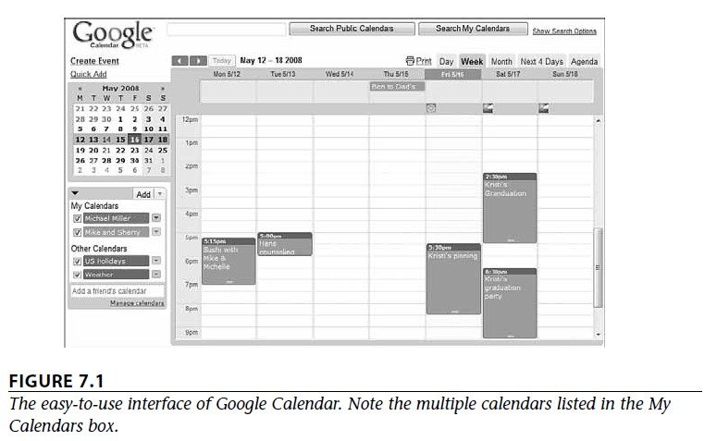
Exploring Online Calendar Applications
Google Calendar
The most popular web-based calendar today, no doubt due to its association with the web’s
most-used search engine, is Google Calendar (calendar.google.com).
Google Calendar is free, full featured, and easy to use.
It lets you create both personal and shared calendars, which makes it ideal for tracking business group, family, and community schedules.
As you can see in Figure 7.1, Google Calendar looks pretty much like every other calendar you’ve ever seen. You enter your appointments (which Google calls “events”) directly into the calendar, which you can display in either daily, weekly, or monthly views.

Slide 21
Exploring Online Calendar Applications
Google Calendar
Types of calendars can you create with Google Calendar?
Personal calendars, like your default calendar:
Like all web-based calendars, all your events are stored in the cloud (in this case, the cloud created by Google’s own network of servers), not on your own computer.
This means that you can access your calendar from any computer anywhere in the world.
Just log in to the Google Calendar page and your calendar and all events are there.
Public calendars, which others can access via the web:
Create a public calendar and all employees or attendees can access it via the web.
In addition, special event invitation features make it easy to invite others to an event—public or private.
Friends’ calendars, which you import from their Google Calendar web pages
Holiday calendars, which add national holidays to a basic calendar
You can create one calendar for home, another for work, and yet another for your son’s soccer team. Then you can view all your calendars from the same Google Calendar page, with the events from each calendar color-coded for easy visibility.
Because it’s part of the mighty Google empire, Google Calendar integrates smoothly with Google’s Gmail application.
Google Calendar can scan your email messages for dates and times and, with a few clicks of your mouse, create contents based on your Gmail messages.

Slide 22
Exploring Online Calendar Applications
Yahoo! Calendar
One of Google Calendar’s primary competitors is Yahoo! Calendar (calendar.yahoo.com), hosted by its search competitor Yahoo!
This web-based calendar looks, feels, and functions quite similarly to Google Calendar,
and is also free for anyone to use.
One subtle difference in Yahoo! Calendar, however, is the presence of an Add Task button.
This reflects Yahoo! Calendar’s offering of tasks in addition to events.
You can still add individual items to your daily schedule, but you can also add longer-term
tasks and have their due dates show up on your calendar.
Can share your Yahoo! calendars with other users, in a collaborative environment.
Just click the Sharing link and indicate how you want to share—no sharing, view-only for
friends, view-only for anyone, or view-only with special friends allowed to edit.

Slide 23
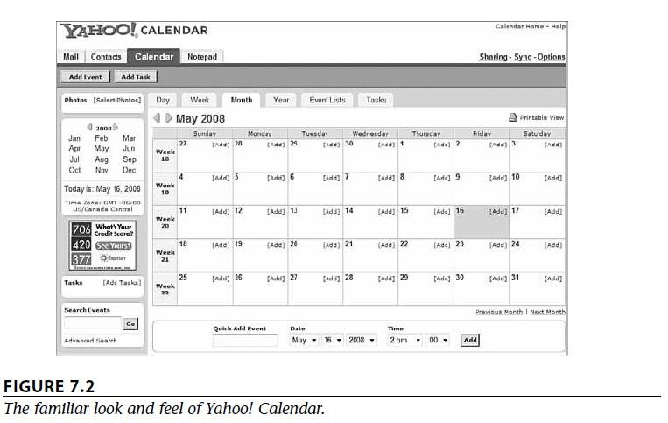
Exploring Online Calendar Applications
Yahoo! Calendar

Slide 24
Exploring Online Calendar Applications
Windows Live Calendar
Windows Live Calendar (mail.live.com/mail/calendar.aspx) is Microsoft’s web-based calendar, actually part of the Windows Live Hotmail email service.
Windows Live Calendar looks a lot like both of its primary competitors (google and Yahoo).
It offers tasks, like Yahoo! Calendar, and also lets you schedule meetings with other calendar and
Hotmail users.
Can share your calendars with authorized users for group collaboration.
Apple MobileMe Calendar
Apple’s MobileMe (www.me.com) is a new competitor in the web-based apps market.
It includes online mail, contacts, and calendar, as well as an online photo gallery and file storage.
The MobileMe Calendar is, of course, a web-based calendar that can be accessed from any computer connected to the Internet, Mac or Windows.
It can also be accessed from Apple’s iPhone, which makes it a truly mobile calendar.
As with competing calendars, you can display MobileMe in daily, weekly, or monthly modes
You can also synchronize your MobileMe calendars with Apple’s iCal and Microsoft Outlook
calendars.

Slide 25
Exploring Online Calendar Applications
AOL Calendar
America Online isn’t quite the powerhouse that it used to be, but it still has millions of users, both paid subscribers and free web users.
Any registered user can access AOL Calendar (calendar.aol.com), which integrates with the AOL Instant Messenger (AIM) service for both instant messaging and email.
As with competing calendars, AOL Calendar lets you share calendars with authorized users;
Calendars can be either private or public.
CalendarHub
Beyond Google, Yahoo!, Apple, and their ilk, many independent sites offer full featured web-based calendars.
CalendarHub offers all the features found in the previously discussed web-based calendars— private/public calendars, sharing/collaboration, multiple calendars, task-based to-do lists, and the like.
In addition, CalendarHub lets you publish calendars on your blog or website, which makes it great for creating sites for community groups, sports teams, and the like.
Other users can sign up to receive email notification of new events, or subscribe to RSS feeds for
any calendar view. And, of course, it’s completely free.

Slide 26
Exploring Online Calendar Applications
Hunt Calendars
Hunt Calendars (www.huntcal.com) offers event-based web calendars.
Useful features include email reminders, notification of event conflicts, notification of new and updated events, and the like.
The site lets you add web links and images to calendar events, which is fairly unique.
Also nice is the ability to customize the color scheme and graphics to reflect your organization’s look and feel.
Hunt Calendars are particularly attractive to businesses and community groups.
Famundo
If you keep the schedule for a community group, check out Famundo (www.famundo.com).
This site offers Famundo for Organizations, a free web-based calendar ideal for schools, churches,
sports teams, and the like.
Can represent different colors for different types of events.
After the public calendar has been created, users can subscribe to be notified of new and upcoming events.
You can also add message boards, blogs, and other features to your calendar.
The company also offers Famundo for Families, a personal version of their Organizations calendar.
This version includes a family address book and message board, to facilitate family
communication.

Slide 27
Exploring Online Calendar Applications
eStudio Calendar
eStudio Calendar (www.same-page.com/calendar-software.html) is designed specifically for business use.
You get three types of calendars in a single interface:
Member Event calendar helps users manage their personal time, keep track of meetings
with others, and so on.
Team Event calendar is used to schedule activities for a group, as well as schedule facilities.
Supervisor calendar provides reports to managers about business activities and schedules.
In addition, you can use eStudio Calendar to broadcast information about group activities (via email) and to schedule meetings.
Information about company events can also be automatically published to your website.

Slide 28
Exploring Online Calendar Applications
30Boxes
The name of 30Boxes (www.30boxes.com) refers to the 30 “boxes” displayed on a typical monthly calendar.
The site itself offers a slick interface for adding events.
All your events can be shared with other designated users, plus you get to-do lists, a link to Google’s Gmail, and similar useful features.
Trumba
Trumba (www.trumba.com) offers web-based calendars ideal for community organizations, schools, and similar public entities.
The company lets you embed individualized widget in your own website.
These widgets let users view full calendars, add events to the schedule, receive email notification of events, and such.

Slide 29
Exploring Online Calendar Applications
Calendars Net
Calendars Net (www.calendars.net) is a free web-based calendar designed for companies or individuals who want to add interactive calendars to their websites.
A typical calendar fits into a frame on your website, with little coding required.
The site also hosts personal calendars in the cloud. You can employ four different levels of security (so that different users can view the calendar), add events, edit events, and even change universal calendar settings.
Jotlet
Here’s another way to add web-based calendar functionality to your website.
Jotlet (www.jotlet.net) is a JavaScript API and library that you can use to build rich calendar functionality into any web page.
If you’re skilled in HTML programming, this is a good way to build a calendar-based page.
The Jotlet API is free for noncommercial use, and also available (for a fee) for commercial
sites.

Slide 30
Exploring Online Scheduling Applications
Online scheduling application is a web-based app takes much of the pain out of scheduling meetings, for both large and small groups.
The typical app requires all users to enter their individual calendars beforehand.
When you schedule a meeting, the app checks attendees’ schedules for the first available free time for all.
The app then generates automated email messages to inform attendees of the meeting request (and the designated time), followed by automatic confirmation emails when attendees accept the invitation.

Slide 31
Exploring Online Scheduling Applications
Jiffle
Jiffle (www.jifflenow.com), which schedules meetings, appointments, and the like for the enterprise environment.
To track employees’ free time, it synchronizes seamlessly with both Microsoft Outlook and Google Calendar.
It also offers its own Jiffle Calendar application.
Jiffle allows the originating user to mark available time slots on his calendar, as shown in Figure 7.10, and then share them with proposed attendees via a Jiffle generated email invitation.
These attendees view the invitation, log in to the Jiffle website, and then select their
preferred time slots from the ones proposed.
Based on these responses, Jiffle picks the best time for the meeting and notifies all attendees via an automatic confirmation email.

Slide 32
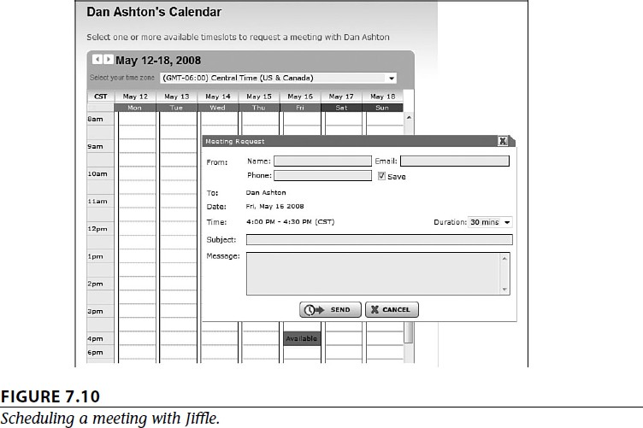
Exploring Online Scheduling Applications

Slide 33
Exploring Online Scheduling Applications
Presdo
Unlike Jiffle, Presdo (www.presdo.com) is a scheduling tool that isn’t limited to a single company.
Presdo lets you schedule meetings and events with anyone who has an email address.
As you can see in Figure 7.11, adding an event is as simple as entering a description into a box.
You then enter the email addresses of other participants, and Presdo emails out the appropriate invites.
When an attendee responds, he’s automatically added to the event’s guest list.
(And, for the convenience of all guests, it’s a one-button process to add an event to a user’s
Microsoft Outlook, Google Calendar, Yahoo! Calendar, or Apple iCal calendar.)

Slide 34
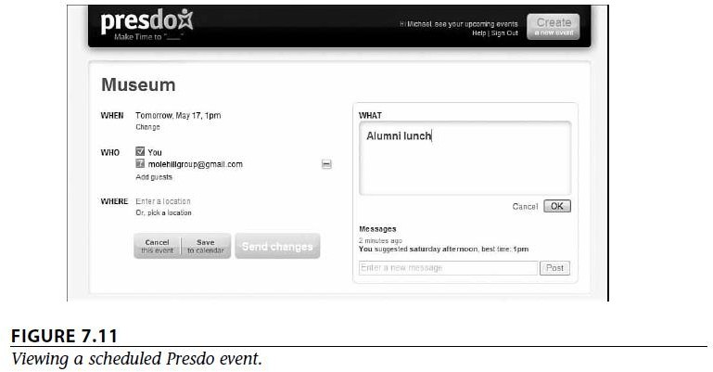
Exploring Online Scheduling Applications

Slide 35
Exploring Online Scheduling Applications
Diarised
Diarised (www.diarised.com) is, like Presdo, a web-based meeting maker that users across
different companies can use.
It helps you pick the best time for a meeting by sending out emails to invitees, letting them choose the best times for them, and then sending you a summary of those best dates.
You pick the final date, Diarised notifies everyone via email, and your meeting is scheduled.
Windows Live Events
Microsoft’s Windows Live Events (home.services.spaces.live.com/events/) is a customized version of its Live Spaces offering; it lets Live Spaces users organize events and share activities between participants.
To schedule an event, you set up a list of invitees and then send out a mass email with a link back to your Live Event site.
(All the event details are also available as an RSS feed.) Information about the event is posted on the site itself, which also serves as a place for attendees to come back after the event and share their photos, videos, and blog posts about the event.
With its user-friendly consumer features, Live Events isn’t robust enough (or professional enough) for most business users.

Slide 36
Exploring Online Scheduling Applications
Schedulebook
Schedulebook (www.schedulebook.com) offers several different types of webbased scheduling services.
Depending on the application, you can use Schedulebook to schedule employees, customers, or other interested parties.
The company’s three offerings are
Schedulebook Professionals, which is a business-oriented schedule/calendar/planning application
Schedulebook Office, which schedules the use of any shared resource, such as company
meeting rooms or even vacation homes
Schedulebook Aviation, which is used by the aviation industry to schedule aircraft, flight training, and similar services

Slide 37
Exploring Online Scheduling Applications
AppointmentQuest
AppointmentQuest (www.appointmentquest.com) is designed to solve the scheduling problems of busy professionals.
This application not only enables clients to make and you to accept appointments over the web, it also lets you manage personnel, schedules, and othe calendar related items.
hitAppoint
hitAppoint (www.hitappoint.com), also enables online client booking.
Like the previous similar application, it’s ideal for any business that requires the making of customer appointments
barbershops,
hair salons,
doctor and dentist offices,
consultants,
financial advisors,
• car repair shops, Computer technicians

Slide 38
Exploring Online Planning and Task Management
Planning and task applications let you manage everything from simple to-do lists to complex group tasks, all over the Internet and collaboratively with other users.
iPrioritize
iPrioritize (www.iprioritize.com) is a good basic to-do list manager.
Authorized users can create a new to-do list, add items to the list, prioritize tasks by
dragging them up and down the list, and mark items complete when finished.
And, because it’s web based, you can access your lists anytime and anyplace.
When you have a list, you can print it out, email it to someone else, subscribe to changes in the list via RSS, and even view lists on your mobile phone— which is a great way to consult your grocery list when at the supermarket!
Bla-Bla List
Bla-Bla List (www.blablalist.com) is another simple to-do list manager.
It’s web based, of course, so you can access your lists from any location at any time.
You can even publish your lists via RSS so that family and coworkers can get instant updates.

Slide 39
Exploring Online Planning and Task Management
Hiveminder
Hiveminder (www.hiveminder.com) is similar to all the previously discussed to-do list managers.
What’s nice about Hiveminder is that you can enter list items in a kind of freeform fashion, and it will help you create and prioritize lists based on your “brain dumps.”
Remember the Milk
When you need to “remember the milk” at the grocery store, check out the aptly named Remember the Milk (www.rememberthemilk.com) web-based todo list manager.
Once you create a list, you can arrange reminders via email, instant messaging, or text messages to your mobile phone.
Ta-da List
Here’s another web-based to-do list manager.
Ta-da List (www.tadalist.com)

Slide 40
Exploring Online Planning and Task Management
Tudu List
Tudu List (www.tudulist.com) is a little different from other to-do list managers in that it also includes a web-based calendar.
Items are added both to the appropriate to-do list and to your calendar, on the date they’re due.
TaskTHIS
TaskTHIS (taskthis.darthapo.com) is similar to most other to-do list managers, but offers the ability to add extended notes to any individual task.
You can publish your tasks via RSS or share with others via the web.
Vitalist
Like other to-do list managers, Vitalist (www.vitalist.com) organizes all sorts of tasks and projects.
It’s unique in that it uses the Getting Things Done (GTD) workflow methodology popularized by management consultant David Allen.

Slide 41
Exploring Online Planning and Task Management
TracksLife
Trackslife (www.trackslife.com) is a database-oriented task manager.
Each “track” is a separate database that combines columns of money, numbers, words, paragraphs, and yes/no responses.
The application sends out reminders of critical events via email or RSS.
Voo2Do
Voo2Do (www.voo2do.com) moves beyond simple to-do list management into more sophisticated priority management.
This web-based application lets you set up different projects, organize tasks by project, track time spent and remaining on a given task or project, publish task lists, and even add tasks via email.
Voo2Do tracks pending and completed tasks via a simple dashboard.
To view tasks sorted by project, click the Projects tab.

Slide 42
Exploring Online Planning and Task Management
HiTask
More sophisticated task management can be had with HiTask (www.hitask.com), a business-oriented task manager.
Tasks are added to your calendar and color tagged for easy viewing.
The task manager and scheduler both utilize drag-and-drop editing, and you can share and assign tasks and projects to a group of people via the web.

Slide 43
Exploring Online Planning and Task Management
Zoho Planner (Important)
Zoho Planner (planner.zoho.com) is perhaps the most sophisticated task planner evaluated here.
Its features and functionality approach those of the project management applications.
With Zoho Plan you create a new page for each project you’re working on, like the one shown in Figure 7.15.
To that project, you add lists with individual to-dos within each list.
Each list item can include extensive notes as well as images.
You can share each project page with users you designate.
Each todo item also appears on your central calendar.
Zoho Planner is ideal for anyone managing small- to medium-sized projects.
It’s probably overkill for simple to-do list management (try iPrioritize or Remember the Milk, instead), and not powerful enough for large corporate projects.
But for the average home or community project, it’s an ideal solution— just enough versatility to handle disparate types of projects, but not so complex as to scare off
nontechnical users.

Slide 44
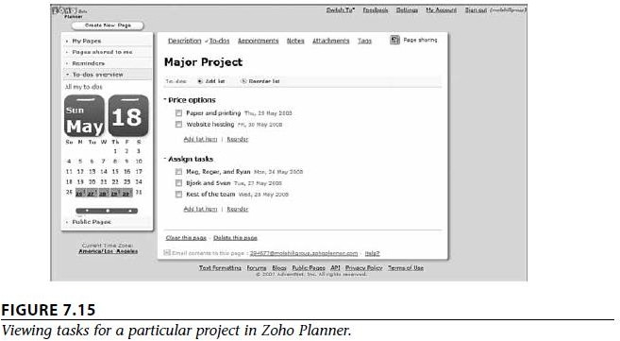
Exploring Online Planning and Task Management

Slide 45
Collaborating on Event Management
Scheduling a company meeting is one thing;
Putting together a large-scale event, such as a conference or seminar or trade show, is quite another.
An undertaking of this scale involves more than just clearing a few schedules and making sure the conference room is free at 10 a.m. on Friday.
A big event is a big project with lots of individual tasks.
To stage a successful event,
you have to market it to potential attendees,
sign up those attendees,
process their fee payments,
make sure that the event space and conference rooms are properly scheduled,
handle travel and hotel arrangements,
register attendees when they arrive onsite,
manage event workers,
and make sure that everything run on time

Slide 46
Collaborating on Event Management
Event Planning and Workflow Management
A successful event starts well in advance of its opening date.
There are tons of details involved in an event of any size, and managing all those tasks takes quite a bit of computing horsepower—just the thing cloud computing can help you out with.
Most event management applications include robust task planning modules.
Need to know which tasks need to be completed before later tasks can be started;
You need to know who’s doing what,
and be alerted to any tasks that are unstaffed or understaffed.
In other words, you need the planning and workflow management functionality to continue into the event itself, so that you can manage your staff in an efficient and effective manner.

Slide 47
Collaborating on Event Management
Event Marketing
Unless you let people know about your event, you could be disappointed with the final attendance.
To that end, many event management applications include modules to help you market your event.
For example, many apps offer web-based email marketing, which lets you promote your
event via targeted email messages.
Other apps help you create your own event website (on their cloud computers), which also helps to promote your event.
Event Calendar
Another part of your event marketing mix is an event calendar.
An online calendar that displays all the happenings within your overall event.
This proves particularly useful if you’re hosting a conference or trade show made of lots of
individual panels, sessions, or meetings.
You can post each individual event on the event calendar easily accessed by any attendee or potential attendee with a web browser

Slide 48
Collaborating on Event Management
Facilities Scheduling
Unless you’re running a one-room meeting, chances are your event involves multiple rooms and maybe event multiple locations.
If so, you need to be able to schedule different rooms for different components of your event;
when a participant or group asks for a room, you need to be able to see what’s available
and when.
To that end, most event management apps include a facilities scheduling module.
Ideally, this module ties into the event host’s systems, giving you complete power over room or hall scheduling.
Advance Registration
Most larger events require or encourage advance registration of participants.
To that end, most event management apps include a web-based registration module,
where attendees can sign up (and, in most cases, pay) for the event.
Attendee information is entered into a webform and the data is then stored in the application provider’s cloud server

Slide 49
Collaborating on Event Management
You then access attendee data from your own computer, wherever you may be.
Some of the more sophisticated advance registration modules provide additional functionality.
For example, you might want to collect demographic or other information from attendees, and then use that information to help plan specific programs during the event.
Or a registration module might tie into a hotel reservations module, to automatically reserve hotel rooms for those who need them.
The registration module is the backbone of the entire event management program.
Budget Management
Running an event is an expensive and complex undertaking; your overall budget includes hundreds of individual expense items.
To that end, your event management application should include a robust accounting or budget management module, to track both your expenses and your income.

Slide 50
Collaborating on Event Management
Post-Event Reporting and Analysis
When the event is (finally!) over, your job isn’t quite done yet.
Not only do you have to balance the books, you also need to look back on the entire event and determine how successful it was.
That’s why most event management applications include some form of post-event reporting and analysis.
Some apps even let you send and process attendee surveys, which can provide valuable feedback from those who were there. Look for a reporting module that lets you see at a glance how you performed to plan in a number of areas, not all of them financial.
(For example, how many hotel rooms were blocked out in advance versus how many rooms
were actually used?)

Slide 51
Collaborating on Event Management
Exploring Event Management Applications
123 Signup
The company offers four different applications:
Event Manager, Association Manager, Training Manager, and Member Directory.
123 Event Manager is scalable,
so it can be used for both smaller (employee meetings, stockholder meetings, alumni meetings, and so forth)
and larger (trade shows, fundraisers, conferences, and so on) events.
The application handles a combination of front-office and back-office tasks.
Front-office tasks include defining and marketing events, automatically generating informational web pages and registration forms, and marketing your event via targeted email messages.
Back-office tasks include event registration, badge printing, payment collection, and
database management.
The program even provides real time reports on registration, attendance, collections, and
other key factors.

Slide 52
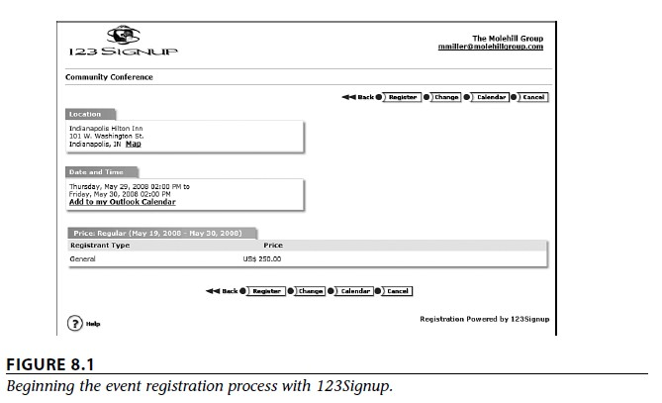
Collaborating on Event Management

Slide 53
Collaborating on Event Management
Acteva
Acteva (www.acteva.com) offers online event registration and payments.
Using Acteva’s web-based solutions, you can handle event registration, ticketing, and payment handling (via any major credit card) directly from your own website.
You can then sort and manage all event registration data online.
Can start by creating what Acteva calls an Active Page for your event;
This is simply a web page with built-in payment handling and data processing. (You create your Active Page by filling in a few web forms—it’s quite easy.)
After you’ve published your event page, you then use Acteva’s EventMail service to send out notification of your event to potential attendees.
Interested parties then visit your Active Page to register and pay for the event.
Acteva processes and confirms event registration and sends an email confirmation to the participant.
You can then use Acteva’s online event management tools to generate will call lists, meal
preference lists, name tags, badges, and the like.

Slide 54
Collaborating on Event Management
Conference.com
Conference.com (www.conference.com) offers one of the most full-featured web- based event management applications available today.
By using Conference.com’s cloud servers, even small events can utilize the company’s powerful event management tools, designed to serve the needs of the largest events.
Your data (and the behind-the-scenes application modules) are hosted by Conference.com’s
secure servers, accessible from any Internet-enabled location.
The features offered are wizard-based event setup, real-time credit authorization, customizable web pages and forms, onsite processing, and the like.
Conference.com’s Event Manager Systems application is actually a suite of interlocking modules, as shown in the diagram in Figure 8.2.

Slide 55
Collaborating on Event Management
These modules include the following:
Appointment Manager, an online meeting scheduling application. This module enables attendees to self-schedule one-to-one sessions with other participants at your event, within time slots that you predefine.
Credit Card Manager, offering real-time credit card authorization integrated into the registration process.
Email Manager, an email broadcasting utility that dynamically pulls recipient names from your registration data.
Export Manager, an export/import utility that lets you copy the data from one event to another event in your database.
Hotel Manager, a professional room block management tool tightly integrated with the company’s Registration Manager module.
Lead Track Manager uses bar code technology to verify session attendance and provide lead tracking services to exhibitors.
Profile Manager links member, employee, customer, and prospect databases with your
conference registration processing, enabling attendees to authenticate themselves through
a login web page.

Slide 56
Collaborating on Event Management
Registration Manager is the core module of Conference.com’s Event Manager systems. This module contains the accounting engine, report engine, a graphical report library, and other functions that integrate directly with other modules in the suite.
Survey Manager enables you to create professional-looking online surveys at any point in the event process. You can solicit pre- or post-event attendee surveys; Survey Manager lets you email invitations with hyperlinks that take the user to the correct survey form.
Travel Manager, which helps you manage ground transfer services between multiple
airports and event hotels.

Slide 57
Collaborating on Event Management
Cvent
Competing directly with Conference.com is Cvent (www.cvent.com), with its Event Management system.
Like Conference.com, Cvent’s Event Management system is a suite of interrelated tools, including the following:
Event Registration, including online event registration, branded event websites, data
collection, and generation of name badges and mailing labels
Email Marketing, with automated invitations, “save-the-date” reminders, confirmations, and post-event “thank you” messages
Secure Online Payment Processing, which lets you accept payment by all major credit
cards—and offer “early-bird” discounts to motivated participants
Housing and Travel Management, which provides a one-step process for attendees to sign up, pay, get a hotel room, reserve an airline flight, and receive all relevant follow-up communications
Contact Management, which creates a professional directory or address book from all
entered participant information.
•

Slide 58
Collaborating on Event Management
Budget Management, which helps you build, track, and analyze budgets for your events
Custom Event Websites, which helps you launch a custom website for your event—
complete with onsite promotion of event sponsors
Event Workflow Management, which helps you manage the entire event planning process from start to finish, complete with to-do list emails for event staff
Event Calendar, a web-based calendar that displays all events open for registration.
On-Site Functionality, which enables you to check in attendees as they arrive onsite, provide self-registration kiosks, print sessionattendee lists, create bar-coded name badges, and process live credit card payments
Event Reporting, which lets you access event data in real-time via a library of standard and
custom reports
Other Event Management Applications are:
Event Wax
Eventsbot
RegOnline
Setdot
Tendenci

Slide 59
Collaborating on Project Management
Understanding Project Management
Project management is the act of planning, organizing, and managing resources to bring about
the successful completion of specific project objectives.
The challenge, of course, is completing the project by the assigned date—and to the agreed- upon budget.
Key to this is the tight management of each and task that comprises the project;
if all the component tasks are completed on time and on budget, the entire project will be completed as planned.
If one or more tasks slip—and you can’t make up the lost time elsewhere—your project will come in late.
To manage the individual tasks within a project requires managing a larger set of resources—people, of
course, but also money, materials, space, communications, and the like.
This resource management is crucial to ensuring the eventual success of a project.
The key to effective project management is to use all available tools and techniques that enable the project team to organize their work to meet these constraints.
And, not surprisingly, one such tool is a web-based project management application.

Slide 60
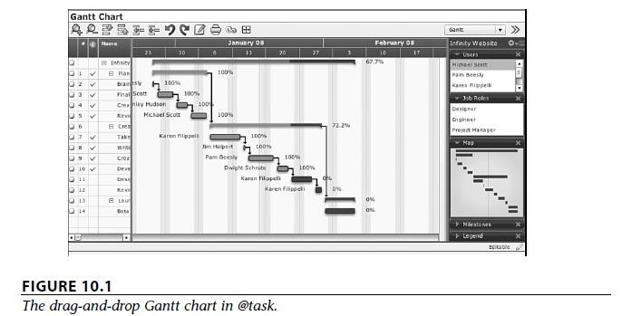
Collaborating on Project Management
@task
The web-based project management program known as @task (www.attask.com) offers a variety of traditional projection management functions.
The application includes an interactive drag-and-drop Gantt chart (shown in Figure 10.1), critical path analysis, project milestones, planned/projected/ estimated comparisons, resource scheduling, issue management, and calendar views for project tasks.
Tasks can even be managed remotely via a special software widget for Apple’s iPhone.

Slide 61
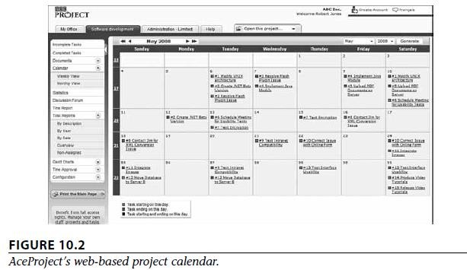
Collaborating on Project Management
AceProject
AceProject (www.aceproject.com) is an easy-to-use web-based project management
application.
It lets users manage multiple projects using multiple resources and share those resources across projects.
Tasks can be tracked via a variety of filters that fine-tune the results, and the application offers a number of different project reports and statistics.
AceProject also offers time tracking, email notification of task deadlines, and a monthly project calendar,
shown in Figure 10.2.
The start and end dates are shown on their individual dates (in green and red, respectively).

Slide 62
Collaborating on Project Management
Basecamp (Imp)
One of the most popular project management applications today is Basecamp (www.basecamphq.com).
Its web-based nature makes it viable for both internal and external (client) projects.
Project management is provided via a special dashboard, shown in Figure 10.3.
The dashboard displays all projects and clients on a single screen, with late items and those
due soon highlighted on the screen.
In addition to standard project management operations such as time tracking and milestones, Basecamp includes
to-do lists,
file sharing,
message boards,
wiki-like web-based documents,
and other group collaboration features.
All web-based pages created by the program can be fully customized

Slide 63
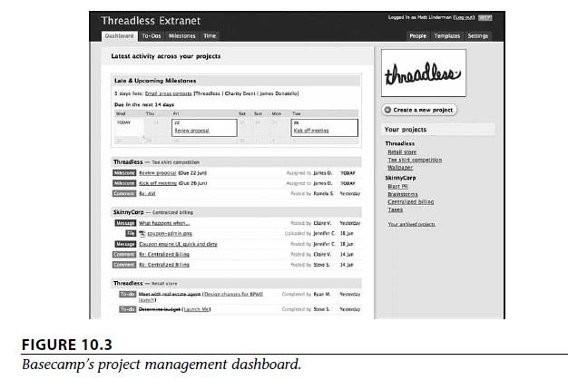
Collaborating on Project Management

Slide 64
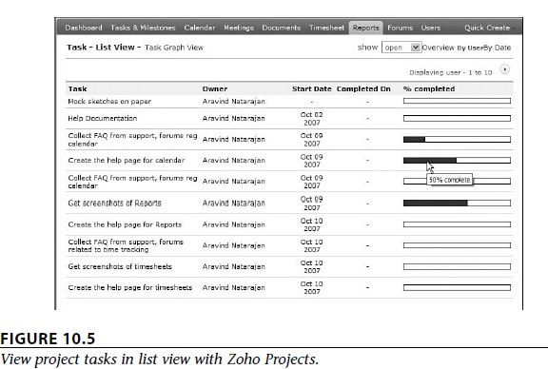
Collaborating on Project Management
Zoho Projects
Zoho Projects (projects.zoho.com), another popular product from the Zoho cloud combine.
Zoho Projects is a standard project management application, complete with tasks and milestones, a project calendar, Gantt charts and other reports (including the task list view shown in Figure 10.5), time tracking, and group file sharing.
Zoho offers several different versions of the Projects application, from a singleproject Free version to the Enterprise version that lets you manage an unlimited number of projects.

Slide 65
Collaborating on Project Management
Other Project Management Applications are:
Copper Project
eStudio TaskTracker
onProject
Project Drive
Vertabase
Wrike

Slide 66
Collaborating on Word Processing
Benefits of Web-Based Word Processors
As you’re by now well aware, the most obvious benefit of using a cloud service is
your documents can be accessed wherever you are, from any PC.
With a web-based word processing application, you’ll never discover that the document you need is located on your office PC when you’re at home or away.
Also nice is that, by being web based, you can easily share your documents with others.
That makes real-time workgroup collaboration possible from anywhere around the globe, which is something you don’t have with Microsoft Word and similar desktop software programs.
Another benefit of being web based is that you can’t lose your work—theoretically, anyway.
After you’ve named the document you’re working on, the web-based word processor saves your file on its cloud of servers. From that point on, every change you make to the document gets saved to the cloud servers automatically.
Nothing gets lost if you close your web browser, navigate to another website, or even turn off your computer. Everything you do is saved on the web.
Best of all, most of these web-based applications are free.
That’s free, as in itcosts zero dollars, unlike the ever increasingly expensive Microsoft Office suite.
Being free makes it easy to take for a test drive, and even easier to add to your bag of applications.

Slide 67
Collaborating on Word Processing
The following users for whom web-based word processing holds promise:
Beginning users. If you’re just starting out in the word processing world, there’s no better place to start than with a web-based application. The slightly limited functionality of these cloud apps actually works to the benefit of beginning users.
Casual users. A web-based word processor is also a good choice if you have modest word processing needs. If all you’re doing is writing memos and letters, a web-based application gets the job done with ease.
Anyone who wants access to their documents from multiple locations. A web-based word processor solves problem of having the data only available ta home. Wherever you are (home, office, on the road), you’re always accessing the same version of your document, stored in the cloud. There are no synchronization issues; you work on the same file wherever you go.
Anyone who needs to share their documents with others. Sometimes you need others to view what you’re working on. Whatever the need, a web-based word processor lets you share your documents with anyone you like, over the Internet.
Anyone who needs to edit their documents in a collaborative environment. Sharing is one thing; collaborative editing is another. If you need multiple users to both access and edit data in a document, a web- based word processor lets you do things that are impossible in Microsoft Word. For example: Google Docs.

Slide 68
Collaborating on Word Processing
The following users should not use web-based word processing :
Power users. If you’ve created your own custom documents or templates in Microsoft Word, especially those with fancy macros and the like, a web-based word processor is not for you.
Anyone who wants to create sophisticated printouts. Most of today’s web-based word processors lack some of the more sophisticated formatting options that some Word users take for granted. Won’t print fancy prinouts.
Anyone working on sensitive documents. Web-based applications (and documents stored on the web) are not good tools if your company has a lot of trade secrets it wants to protect.
Anyone who needs to work when not connected to the Internet. This is the blatantly obvious one, but if you’re not connected to the Internet, you can’t connect to and work with a web-based application. To work offline, you need Microsoft Word.

Slide 69
Collaborating on Word Processing
Exploring Web-Based Word Processors
Google Docs (Imp)
Google Docs (docs.google.com) is the most popular web-based word processor available today.
Docs is actually a suite of applications that also includes Google Spreadsheets and Google Presentations;
the Docs part of the Docs suite is the actual word processing application.
Like all things Google, the Google Docs interface is clean and, most important, it works well without imposing a steep learning curve.
Basic formatting is easy enough to do, storage space for your documents is generous, and sharing/ collaboration version control is a snap to do.
To create a new word processing document, click the New button and select Document.
Your document looks like a big blank space in this new browser window, one with a pull- down menu and toolbar at the top.
You use the toolbar buttons and the functions on the pull-down menu to edit and format
your document.

Slide 70
Collaborating on Word Processing
Zoho Writer (Imp)
In most instances, Zoho is right up with Google in terms of functionality and features.
Zoho Writer (writer.zoho.com), which easily holds its own, if not surpasses, Google Docs in the web-based word processor race.
Multiple documents display in a single window, thanks to Zoho Writer’s tabbed interface.
You get all the standard editing and formatting features, as well as page numbering, headers and footers, footnotes and endnotes, tables of contents, and other advanced features not found in all other web-based word processors.
Other Web-Based Word Processors
ajaxWrite
Docly
Glide Write
iNetWord
Kbdocs
Peepel WebWriter
ThinkFree Write
WriteBoard

Slide 71
Collaborating on Databases
How Databases Work
A database does many of the same things that a spreadsheet does, but in a different and often more efficient manner.
You can use a database application to create and store anything that includes a large amount of data.
For example, you can create a database that contains all your favorite recipes.
For businesses, databases tend to house large amounts of granular data— information about customers, employees, and sales.
A database management program not only stores this data but also automates data entry, retrieval, and analysis.
Many businesses build custom applications around their databases, so that the database itself becomes somewhat transparent.
Users see only the front end that pulls information from the database.

Slide 72
Collaborating on Databases
How Online Databases Work
A local database is one in which all the data is stored on an individual computer.
A networked database is one in which the data is stored on a computer or server connected to a network, and accessible by all computers connected to that network.
Finally, an online or web-based database stores data on a cloud of servers somewhere on the Internet, which is accessible by any authorized user with an Internet connection.
The primary advantage of a web-based database is that data can easily be shared with a
large number of other users, no matter where they may be located.
When your employee database is in the cloud, for example, the human resources department in your Alaska branch can access employee information as easily as can the HR staff in Chicago—as can HR managers traveling across the country to various college job fairs.
And, because the data itself is stored in the cloud, when someone at one location updates a
record, everyone accessing the database sees the new data.
Synchronization is not an issue

Slide 73
Collaborating on Databases
Exploring Web-Based Databases
Blist
One of the newest entrants in the web-based database market is Blist (www.blist.com).
Blist is a relatively easy-to-use database designed for nontechnical businesspeople; in fact, the company bills it as something of a cross between a spreadsheet and database program.
Not surprisingly, the default Blist interface uses a spreadsheet metaphor, complete with rows and columns.
Can switch to a forms-based interface, which is perhaps better for entering raw data one record at a time.
Blist provides some robust database management and reporting capabilities.
You can make your data completely public or share it with designated users.
Databases can be read-only, or users can have the option of adding new records or deleting old ones.

Slide 74
Collaborating on Databases
Cebase
Cebase (www.cebase.com) lets you create new database applications with a few clicks of your mouse;
Fill in a few forms and make a few choices from some pull-down lists.
Data entry is via web forms, and then your data is displayed in a spreadsheet-like layout.
Can sort, filter, and group your data as you like.
Sharing is accomplished by clicking the Share link at the top of any data page.
Can invite users to share your database via email, and then adjust their permissions after they’ve accepted your invitation.
Zoho Creator
Offers two different database products: Zoho Creator and Zoho DB & Reports.
Of the two, Zoho Creator is the easiest to use and best suited for casual users.
Zoho Creator (creator.zoho.com) is a versatile data repository, complete with data-entry forms and spreadsheet-like list views.

Slide 75
Collaborating on Databases
Zoho DB & Reports
If your database needs are more robust, turn to Zoho DB & Reports (db.zoho.com).
Zoho DB offers more in-depth reporting than is available with Zoho Creator, including charts, pivot tables, and other report types.
In addition, Zoho DB supports web-based APIs that enable it to serve as a back end for your own hosted applications;
It also supports SQL for more robust data queries.
Like Zoho Creator, Zoho DB can be accessed from any Internet-connected computer.
You can also share your data and reports for collaborative development and analysis and embed your reports into your own website.

Slide 76
Collaborating on Databases
Other Web-Based Databases are:
Dabble DB
Lazybase
MyWebDB
QuickBase
TeamDesk
Trackvia

